Slide 1

CS-M151B
Computer Systems Architecture
Blaise Tine
UCLA Computer Science

Slide 2

Attendance

Slide 3
Agenda
Caches

Slide 4
Exercise: let’s design a cache
We need a cache for a 32-bit RISC-V CPU
Our load/store unit can only fetch word-aligned block
How many bits is the address bus?
Answer: 32-log2(4) = 30 bits

Slide 5
Exercise: let’s design a cache
We can only afford 512 bytes of cache storage and our memory bus is 64 bytes
How many total blocks can we host inside our cache?
Answer: 512 / 64 = 8 blocks or 8 cache lines

Slide 6
Exercise: let’s design a cache
Assume direct mapped placement
Describe the cache address bits mapping?
[ tag | index | offset ]
Answer
offset = 64 / 4 = 16 words => 4 bits
Index = 8 / 1 = 8 => 3 bits
Tag = 30 – 4 – 3 = 23 bits
8 sets of 1 way each
7
6
5
4
3
2
1
0

Slide 7
Exercise: let’s design a cache
Assume 2-way set associative placement
Describe the cache address bits mapping?
[ tag | index | offset ]
Answer
offset = 64 / 4 = 16 words => 4 bits
Index = 8 / 2 = 4 => 2 bits
Tag = 30 – 4 – 2 = 24 bits
4 sets of 2 ways each
7
6
5
4
3
2
1
0

Slide 8
Exercise: let’s design a cache
Assume fully associative placement
Describe the cache address bits mapping?
[ tag | index | offset ]
Answer
offset = 64 / 4 = 16 words => 4 bits
Index = 8 / 8 = 1 => 0 bits
Tag = 30 – 4 – 0 = 26 bits
1 set of 8 ways each
7
6
5
4
3
2
1
0

Slide 9
Exercise
Assume direct-mapped cache with 8 blocks that is initially empty
Here is a series of address references given as block address (offset removed): 1,4,2,5,12,4,1,5.
Label each reference in the list as a hit and show the final contents of the cache.
0
1 | 1,1
2 | 2
3
4 | 4,12,4
5 | 5,5
6
7
0
1 | 1
2 | 2
3
4 | 4
5 | 5
6
7
1%8 =1
4%8 = 4
2%8 = 2
5%8 = 5
12%8 = 4
4%8 = 4
1%8 = 1
5%8 = 5

Slide 10
Exercise
Assume 2-way set associative cache with 8 blocks and LRU replacement that is initially empty
Here is a series of address references given as block address (offset removed): 1,4,2,5,12,4,1,5.
Label each reference in the list as a hit and show the final contents of the cache.
1%4 =1
4%4 = 0
2%4 = 2
5%4 = 1
12%4 = 0
4%4 = 0
1%4 = 1
5%4 = 1
0 | 4,4 | 12
1 | 1,1 | 5,5
2 | 2
3
0 | 4 | 12
1 | 1 | 5
2 | 2
3

Slide 11
Review: Cache Indexing
2 Ways set associative
dex
TAG
Index
offset
TAG0
TAG2
DATA0
DATA1
=
=
Logic
YES
Data
HIT
YES

Slide 12
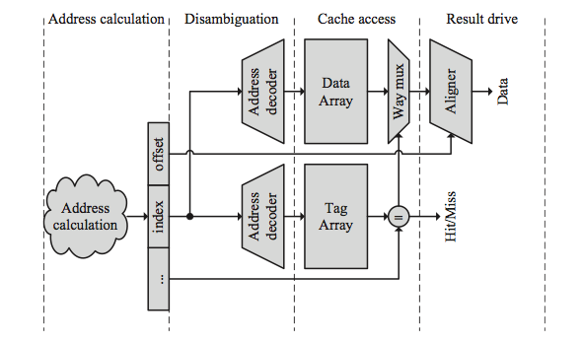
Parallel TAG and Data Array Access Pipeline
Four pipeline stages
Tag & Data parallel access
Need a way multiplexer
Fetch ways lines from data array
Since we don’t have the way index yet from tag compare
Two critical paths
Tag access + compare + mux
Data access + mux

Slide 13
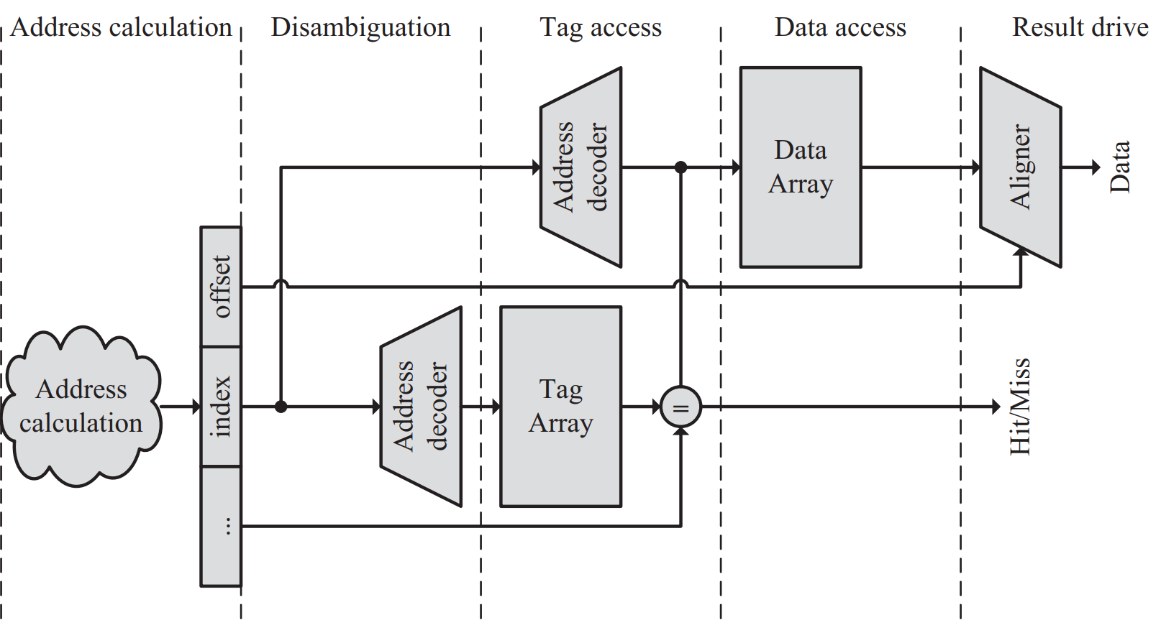
Serial TAG and Data Array Access Pipeline
Five pipeline stages
One extra cycle
Tag & Data serial access
No way multiplexer
We have the way index
We can select our data line
One smaller critical path
Tag access + compare

Slide 14
Cache Replacement
Need a free line to insert new block
Which block should we kick out?
Several strategies
Random (randomly selected line)
FIFO (line that has been in cache the longest)
LRU (least recently used line)
LRU Approximations (Pseudo LRU)
Notes:
Pseudo LRU use a binary tree as optimization

Slide 15
Cache Replacement
Random Replacement
Use per-set counter
Increment on set access
On replacement, use counter current value
Pros: efficient
Cons: bad approximation

Slide 16
Cache Replacement
LRU Replacement
Have LRU counter for each line in a set
When line accessed
Set its counter to max value
Saturate-decrement other lines counters
When replacement needed
Select line whose counter is 0
Pros: expensive
Cons: good approximation

Slide 17
Cache Replacement
Example: 4 lines cache
Initial state: 0,0,0,0
Fill line0: 3,0,0,0 (LRU=1)
Fill line1: 2,3,0,0 (LRU=2)
Hit line0: 3,2,0,0 (LRU=2)
Fill line2: 2,1,3,0 (LRU=3)
Fill line3: 1,0,2,3 (LRU=1)
Fill line1: 0,3,1,2 (replaced line1)
Fill line0: 3,2,0,1 (replaced line0)

Slide 18
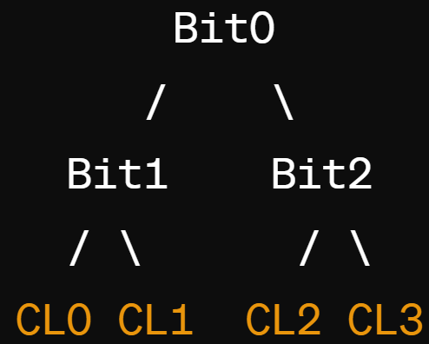
Cache Replacement
Tree-based Pseudo-LRU Replacement
Use binary tree to locate your cache line
0=> left, 1=>right
On access construct the MRU path
Save MRU path into a per-set register
On replacement LRU=~MRU
Pros: efficient
Cons: weak approximation
Line | Encoding bits
Line0 | _00
Line1 | _10
Line2 | 0_1
Line3 | 1_1
‘_’ means unchanged

Slide 19
Cache Replacement
Assume 4-way set associative cache
Need 3 bits to address each block
MRU initially set to 000
Accesses: line2 -> line1 -> line3 -> line0 -> line2
MRU register: 001 -> 010 -> 111 -> 100 -> 001
PLRU = ~001 = 110 => line1
Line | Encoding bits
Line0 | _00
Line1 | _10
Line2 | 0_1
Line3 | 1_1
‘_’ means unchanged

Slide 20
Write Policy
Do we allocate cache lines on a write miss?
Write-allocate
A write miss brings block into cache
No-write-allocate
A write miss leaves cache as it was
Pros and cons?
Depends on temporal locality

Slide 21
Write Policy
Do we update memory on writes?
Write-through
Memory immediately updated on each write
Generally combined with no-write-allocate
Write-back
Memory updated when line is replaced
Generally combined with write-allocate

Slide 22
Write through / Write back
PROC
CACHE
MEM
Write-through
PROC
CACHE
MEM
Write-back
replacement

Slide 23
Writeback Caches
Need a Dirty bit for each line (stored in the Tag!)
A dirty line has more recent data than memory
Need dirty bytes storage as well (optional)
Line starts as clean (not dirty)
Line becomes dirty on first write to it
Memory not updated yet, cache has the only up-to-date copy of data for a dirty line
Replacing a dirty line
Must write data back to memory (write-back)

Slide 24
Types of Cache Misses
The “3 Cs”
Compulsory: have to have these
Miss the first time each block is accessed
Capacity: due to limited cache capacity
Would not have them if cache size was infinite
Conflict: due to limited associativity
Would not have them if cache was fully associative
Notes:
- Applicable to
- Critical word first will reorder the transfer

Slide 25
Cache Performance
Miss rate
Fraction of memory accesses that miss in cache
Hit rate = 1 – miss rate
Miss penalty ~ cache access + memory latency
Average memory access time
AMAT = hit_latency + miss_rate * miss_penalty

Slide 26
Cache Performance
Another CPU runtime latency model
CPUTime = CycleTime x (Cycles_{Exec} + Cycles_{MemoryStall})
Cycles_{MemoryStall} = CacheMisses x (MissLatency_{Total} – MissLatency_{Overlapped})
Overlapped miss latency: duration of memory access time while processor is doing other work

Slide 27
Improving Cache Performance
Improving Average Memory Access Time
AMAT = hit_time + miss_rate * miss_penalty
Reduce miss penalty
Reduce miss rate
Reduce hit time

Slide 28
Improving Cache Performance
Improving memory stall cycles
Cycles_{MemoryStall} = CacheMisses x (MissLatency_{Total} – MissLatency_{Overlapped})
Increase overlapped miss latency
Increase memory level parallelism (MLP)
Notes:
Increase overlapped miss latency
- Need a non-blocking cache
- Schedule more instructions while waiting on memory (OOO)
Memory level parallelism => handling multiple memory requests in parallel
Banking
MHSR

Slide 29
Improving Cache Performance
Memory latency = 100 cycles
16KB cache, 3 cycle latency, 85% hit rate
What’s the baseline AMAT?
= 3+100*0.15 = 18 cycles
Which cache configuration reduces latency?
Smaller 8KB cache: 1 cycle latency, 75% hit rate
= 1+ 100*0.25 = 26 cycles
Larger 32KB cache: 4 cycle latency, 90% hit rate
= 4 + 100*0.1 = 14 cycles

Slide 30
Hiding Miss latency
Idea: overlap miss latency with useful work
Also called “latency hiding”
Non-blocking (Lockup-free) caches
A blocking cache services one access at a time
While miss serviced, other accesses blocked (wait)
Non-blocking caches remove this limitation
While miss serviced, can process other requests
Prefetching
Predict what will be needed and get it ahead of time

Slide 31
Non-Blocking (Lockup-Free) Caches
Hit Under Miss
Allow cache hits while one miss in progress
But another miss has to wait
Miss Under Miss, Hit Under Multiple Misses
Allow hits and misses when other misses in progress
Memory system must allow multiple pending requests
MSHR (Miss Status Holding Register): Stores missed cache requests that are pending for memory.

Slide 32
MSHR
Track address, data, and status for outstanding cache misses
Provide correct memory ordering, other information (e.g, cache coherence)
Can be shared by multiple caches
Has fixed capacity: isfull check
CPU Pipeline
DCache
MSHR
Memory

Slide 33
Reducing Cache Miss Penalty
Multilevel caches
Very Fast, small Level 1 (L1) cache
Fast, not so small Level 2 (L2) cache
May also have slower, large L3 cache, etc.
Why does this help?
Miss in L1 cache can hit in L2 cache, etc.
AMAT = HitTime_{L1}+MissRate_{L1} x MissPenalty_{L1}
MissPenalty_{L1}= HitTime_{L2}+MissRate_{L2}x MissPenalty_{L2}
MissPenalty_{L2}= HitTime_{L3}+MissRate_{L3}x MissPenalty_{L3}

Slide 34
Reducing Cache Miss Penalty
Handling memory overlap with multi-level caches
Inclusion Property
If block A is in L1 cache, it must also be in L2 cache
Simpler data management (fill/eviction)
Exclusion Property
If block is in L1 cache, it is not in L2 cache
Higher total capacity => improved hit rate
Complex data management (fill/eviction)

Slide 35
Reducing Cache Miss Penalty
Exercise: Which is better?
Memory latency = 100 cycles
Single cache
16KB L1 cache, 3 cycle latency, 85% hit rate
Two-level of caching
Smaller 8KB cache: 1 cycle latency, 75% hit rate
Larger 128KB cache: 6 cycle latency, 60% hit rate

Slide 36
Reducing Cache Miss Penalty
Prioritizing memory transactions
Block transfer can take time if bus too narrow
Give data to loads before entire block arrive
Early restart
When needed word arrives, let processor use it
Then continue block transfer to fill cache line
Critical Word First
Transfer loaded word first, then the rest of block
Why this can be expensive?
Use with early restart to let processor go ASAP
Notes:
- Applicable to
- Critical word first will reorder the transfer

Slide 37
Reducing Cache Miss Penalty
Prioritize load misses
Loads can have dependent instructions
If a load misses and a store needs to go to memory, let the load miss go first
Need a write buffer to hold stores
Merge write requests
If multiple write misses to the same block, combine them in the write buffer
Use block-write instead of a many small writes
Notes:
- Applicable to
- Critical word first will reorder the transfer

Slide 38
Reducing Cache Miss Rate
Victim Caches
Recently evicted blocks are kept in small cache
If we miss on those blocks, can get them fast
Why does it work?
Exploit conflict misses
Example:
A 64KB direct-mapped L1 cache combined with a 1KB fully associative victim cache
Notes:
- Applicable to
- Critical word first will reorder the transfer

Slide 39
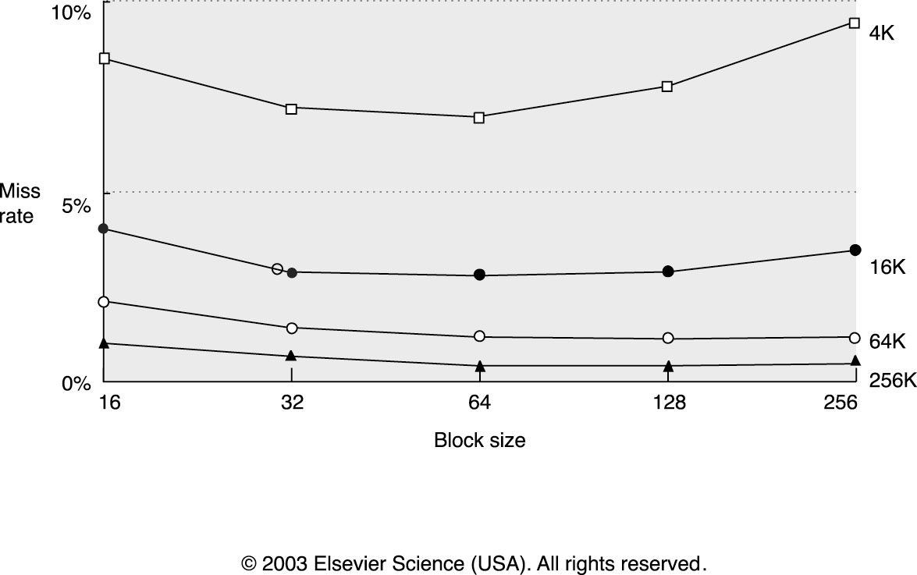
Reducing Cache Miss Rate
Larger blocks
Helps if there is more spatial locality
Notes:
- Applicable to
- Critical word first will reorder the transfer

Slide 40
Reducing Cache Miss Rate
Larger caches
Fewer capacity misses,
But longer hit latency!
Higher associativity
Fewer conflict misses
But longer hit latency!
Which is better?
Need to work through AMAT equations to figure out which is better
Notes:
- Applicable to
- Critical word first will reorder the transfer

Slide 41
Reducing Cache Miss Rate
Pseudo Associative Caches
Similar to way prediction
Start with direct mapped indexing
If miss on “primary” entry, try another entry
Use hash function to determine other indices to check
Results in varying access
Notes:
- Applicable to
- Critical word first will reorder the transfer

Slide 42
Reducing Cache Miss Rate
Compiler optimizations
Loop interchange
Blocking (e.g., tiled matrix multiplication)
Notes:
- Applicable to
- Critical word first will reorder the transfer

Slide 43
Reducing Cache Miss Rate
For loops over multi-dimensional arrays
Example: matrices (2-dim arrays)
Change order of iteration to match layout
Gets better spatial locality
Layout in C: last index changes first
for(j=0;j<10000;j++) for(i=0;i<40000;i++) c[i][j]=a[i][j]+b[i][j];
for(i=0;i<40000;i++) for(j=0;j<10000;j++) c[i][j]=a[i][j]+b[i][j];
a[i][j] and a[i+1][j] are 10000 elements apart
a[i][j] and a[i][j+1] are next to each other
Notes:
- Applicable to
- Critical word first will reorder the transfer

Slide 44
Reducing Cache Miss Rate
Reduce the working set size.
To make the code fit into the cache
Example
1D case
for (k = 0; k < N; k++)
for (j=0; j<M; j++)
if (B[j] == a[k]) sum[k]++;
If one element in B is 4B and the total cache size is 1KB.
1KB/4B = 256 elements; So
for (j=0; j<M/256; j++)
for (k = 0; k < N; k++)
for (l = 0; l< 256; l++)
if (B[j*256+l] == a[k]) sum[k]++;
Notes:
- Applicable to
- Critical word first will reorder the transfer

Slide 45
Other software Optimization for caches
Data alignment
increase spatial locality in cache block
aligned_malloc(addr, alignment);
Use Hint bits:
Indicate temporal locality
Notes:
- Applicable to
- Critical word first will reorder the transfer

Slide 46
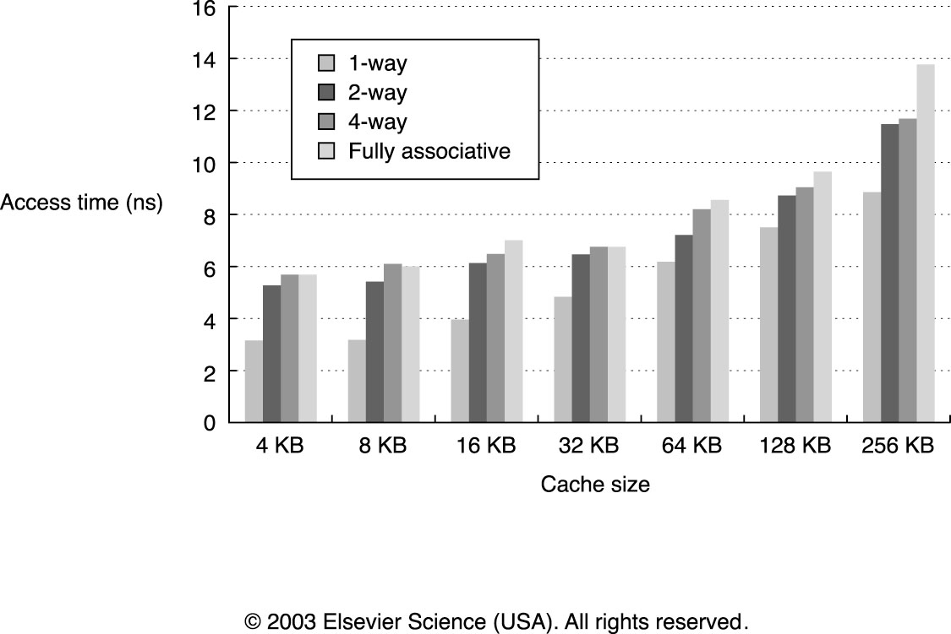
Reducing Hit Time
Small & Simple Caches are faster
Notes:
- Applicable to
- Critical word first will reorder the transfer

Slide 47
Reducing Hit Time
Pipelined Caches
Improves bandwidth, but not latency
Essential for L1 caches at high frequency
Even small caches have 2-3 cycle latency at N GHz
Multi-banked caches
Increases bandwidth and MLP
Trace Caches
For instruction caches
Way Prediction
Speeds up set-associative caches
Predict which of N ways has our data, fast access as direct-mapped cache
If mispredicted, access again as set-assoc cache
Notes:
- Applicable to
- Critical word first will reorder the transfer

Slide 48
Q&A

Slide 49
Acknowledgement
This course is partly inspired and use materials from the following courses created by my colleagues:
ECE-M1126C: Nader Sehatbakhsh @ UCLA
CS3220: Hyesoon Kim @ gatech

